Slide 1
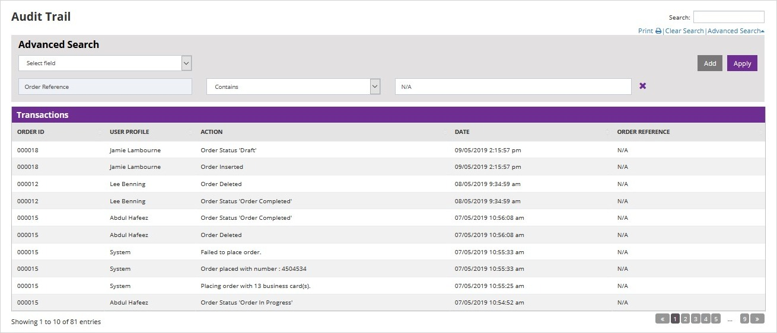
SEE WHO HAS ORDERED WHAT AND WHEN

Slide 2
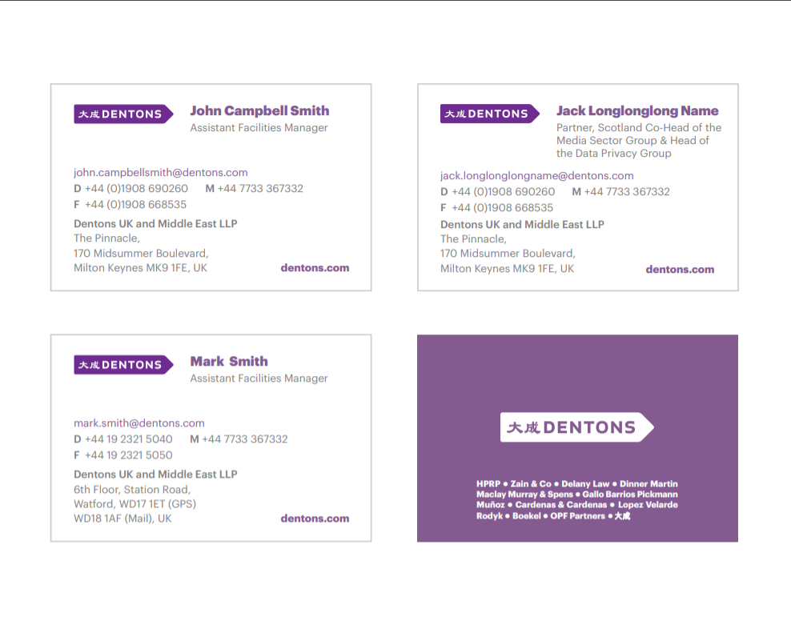
MINIMUM COMBINATION TO CATER FOR MAXIMUM VARIABLES

Slide 3
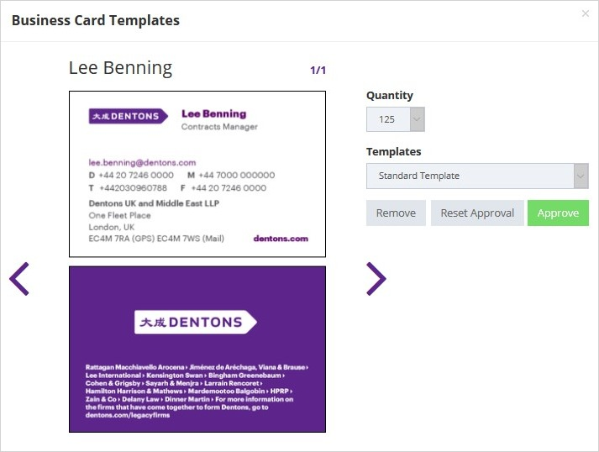
CHECK ON LAYOUT AND ORDER CARDS AGAINST A PRE-DEFINED TEMPLATE

Slide 4
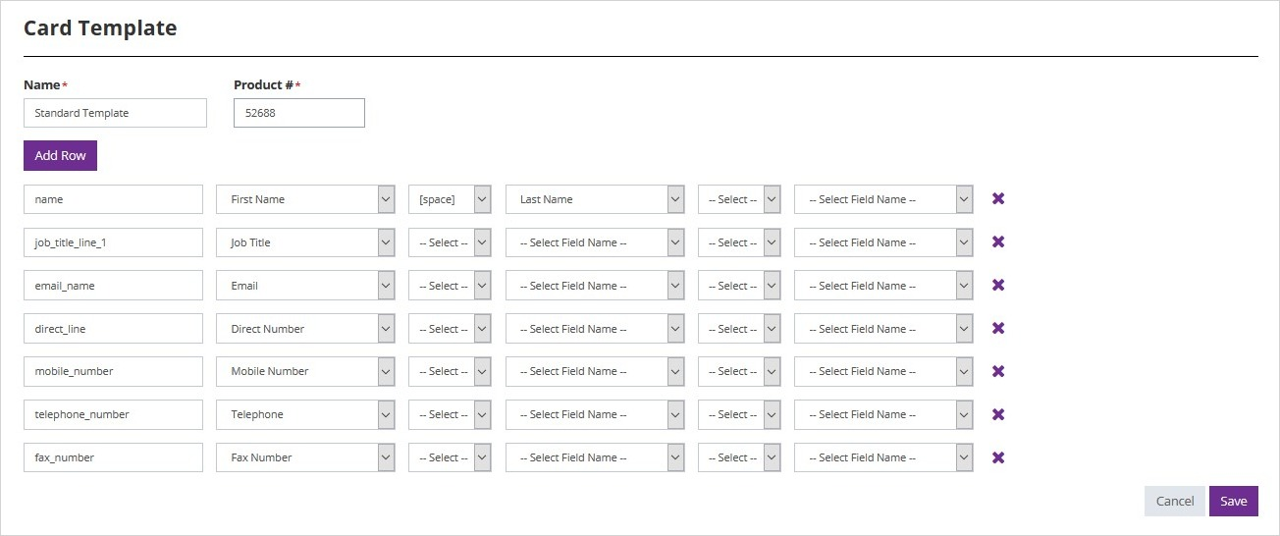
HOW TO CREATE A NEW CARD TEMPLATE

Slide 5
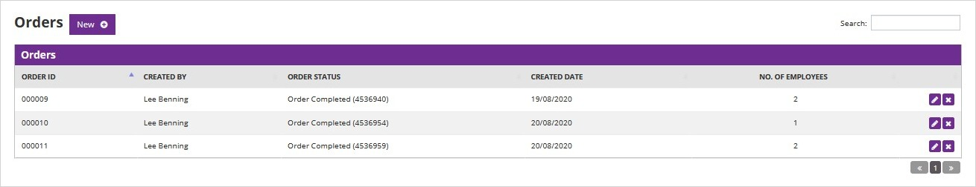
CHECK ON STATUS OF ORDERS

Slide 6
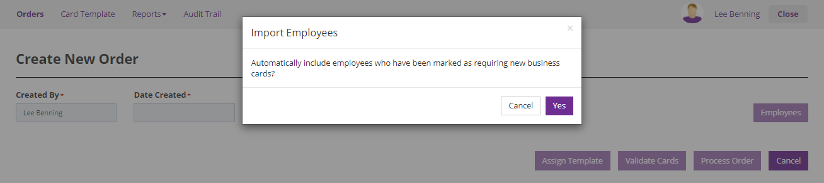
HOW TO CREATE A NEW ORDER

Slide 7
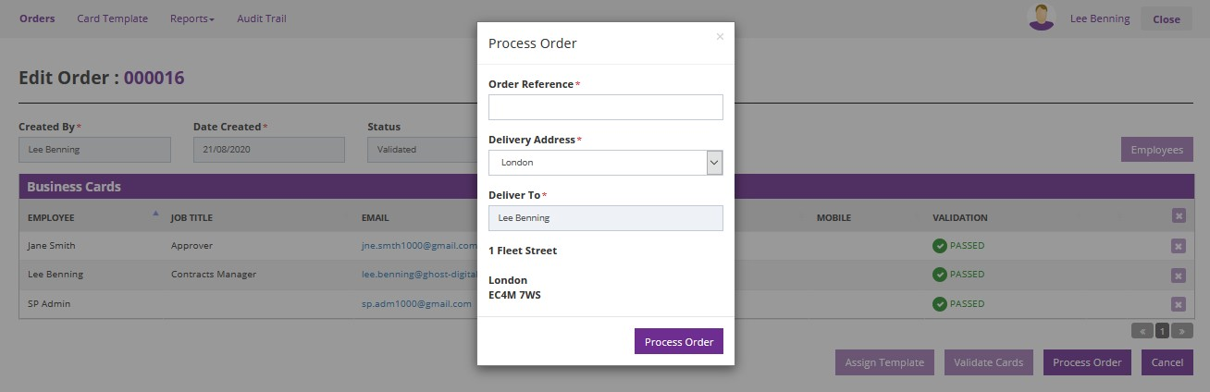
HOW TO PROCESS AN ORDER

Slide 8
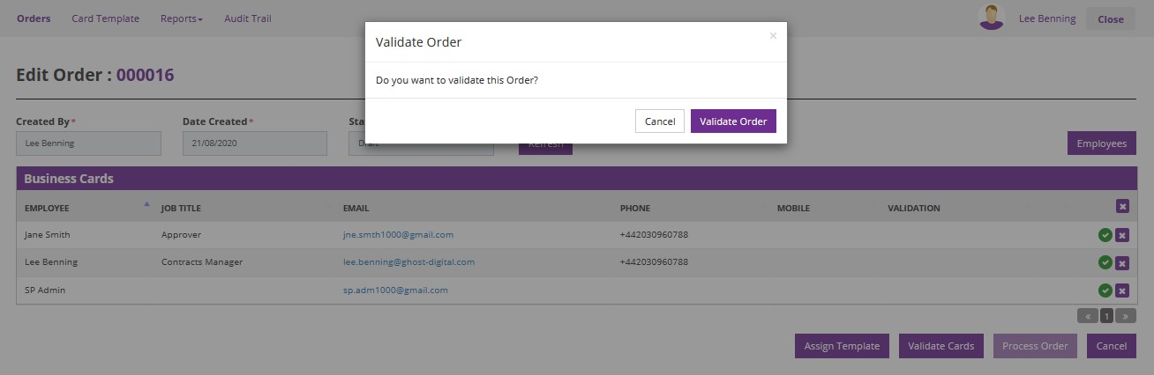
HOW TO VALIDATE AND ORDER

Slide 9
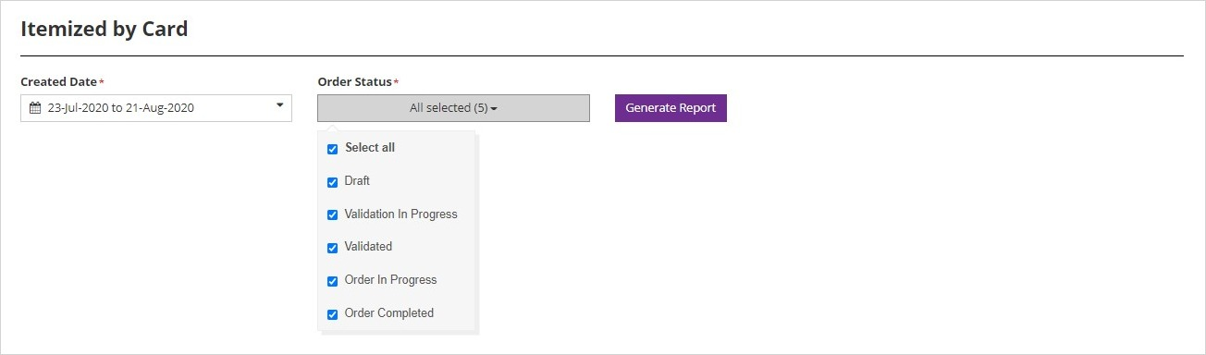
HOW TO RUN REPORTS TO CHECK WHAT HAS BEEN DONE OVER TIME

